Slide 1

SpiralGen Technology: Solutions that give you the optimization you need, when you need it. _____________________________ Is your algorithm optimized for the latest architecture? SpiralGen can deliver software components to your specifications. How long did it take to perform your last optimization? SpiralGen technology can deliver code in days instead of weeks, or weeks instead of months. Are you prepared to do it again for the next platform? SpiralGen can easily port to new architectures. Your optimization will have a longer life. How reliable is your optimized code? SpiralGen software components are symbolically and numerically verified. What happens to your optimization when your algorithm changes? With SpiralGen, algorithm changes are done at the symbolic levels, not in C or assembler. Your algorithm becomes maintainable and portable. Would you like to achieve a higher power efficiency? SpiralGen software components can exceed the performance of code written by human optimization experts, delivering more GFLOPS/Watt. _____________________________ Contact SpiralGen at 412.567.1010 or info@spiralgen.com for more information about our services.
simplifying PERFORMANCE
Highly Optimized Source Code for….
Your Platform
SSE 2/3/4 and FMA4
AVX
MIC and LRBni
VMX/AltiVec/VSX
Atom
ARM
SPARC
Core i3/i5/i7
Opteron
BlueGene/L/P/Q
Fermi and Tesla
Others….
Your Algorithm and Application
Electronic structure computation
Quantum chemistry
Physics and cosmology
Seismic analysis
Uncertainty quantification
Biology and bioinformatics
Climate Modeling
Finance and optimization
Finite elements
Particle in cell
CFD
Fast multipole and n-body
Integral codes
Social Networks
Cloud Computing
CS education
Visualization
HPC Challenge
Your Library Interface
MKL
IPP
ACML
(P)ESSL
NAG
IMSL
GSL
FFTPACK
Your Functionality
Fast Fourier Transforms (FFT)
Small Matrix BLAS
Correlation and Convolution
Wavelets and Filter Banks
Others….
Your Implementation Details
Data
Single/Double/Extended and mixed Precision Floating Point
Array of Structs vs. Struct of arrays
Others…
Memory Allocation
Stack
Dynamic (Heap)
Dynamic (User-Provided memory Allocator)
Others…
Threading and Messaging
Fork/Join, Leverage Existing Threads (Multiple Entry-Points)
Open MP
PThreads
MPI
GASNet
Global Arrays
UPC and CAF
CUDA
OpenCL
Boost
Thread Building Blocks
HPCS languages (Chapel, X10)
MapReduce
Others…
Language
C&C++
Fortran 77, 90, 95
Java C#
Others…
Operating System
Unix
Linux
Windows HPC Server
AIX

Slide 2
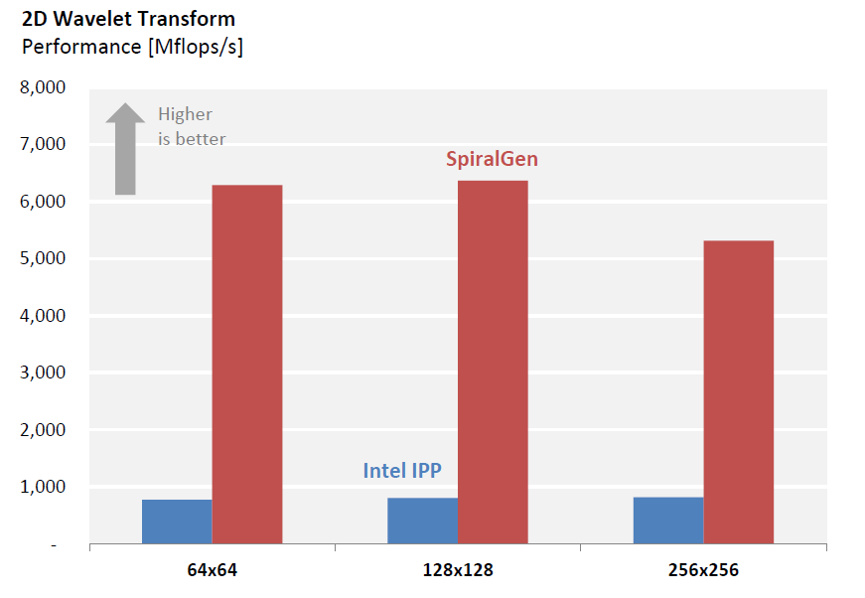

SpiralGen Services
Highly Optimized Custom Components
SpiralGen provides performance-critical software components for your target application, standard, and platform.
Performance Consulting
Review your application/algorithm and recommend an architecture, hardware and software approach.
Benchmarking
Benchmark and analyze the performance of your application, estimate realizable speedup, and recommend relevant software components and services.
Integration and Maintenance
Installation, integration, testing and upgrade services for SpiralGen components.
SpiralGen Expertise
SpiralGen components harness the expertise of some of the world’s leading experts on parallel programming and high performance optimization and deliver it to your application.
SpiralGen holds the exclusive license to the Spiral software generation and optimization technology developed under the lead of Carnegie Mellon University. The technology is the result of more than a decade of research and $12 million of funding, and combines the collaborative research and development output of faculty members from signal processing, algorithm design, computer architecture, compilers, computer algebra, high performance computing and machine learning, 25 graduate students and 5 postdoctoral researchers. Results have been published in more than 20 journal and 60 peer-reviewed conference articles.
SpiralGen delivers superfast software components for cutting edge parallel platforms. Contact us to discuss your optimization needs and see how SpiralGen can help you now.
SpiralGen Benefits
Faster time-to-market
Higher performance
Higher reliability
Higher maintainability
Faster porting to new architectures
Plug-n-play with your API
Reduced Risk.
201 S. Craig St., Suite 2E|Pittsburgh, PA 15213
412.567.1010|info@spiralgen.com|www.spiralgen.com

